Slide 1
INDOOR AIR POLLUTANTS

Slide 2
Contents
Indoor Air Quality(IAQ)
Relevant Data
Indoor Air Pollutants
Common Pollutants and Effects
Summary

Slide 3
Indoor Air Quality(IAQ)
Refers to air quality within buildings and structures
Relates to health and comfort of building occupants
Affected by gases like CO, C02, NOx, SOx, radon
Also affected by bacteria and particulates
Source Control, Filtration, proper Ventilation can improve IAQ
Residential Sanity is the most to improve IAQ

Slide 4
Relevant Data
In March 2010, WHO estimates 4.3 million die annually from household air pollution
Environmental Protection Agency (EPA) has shown that 2.8 million die annually in developing countries due to indoor smoke
In developing countries more than 50% of the victims are below 5 years
EPA has shown that 10 common pollutants are 2.5 times greater inside homes and commercial buildings than outside
Inside cars in traffic-clogged areas the pollution may be 18 times higher than outside
People usually spend 70-98% of their time inside home

Slide 5
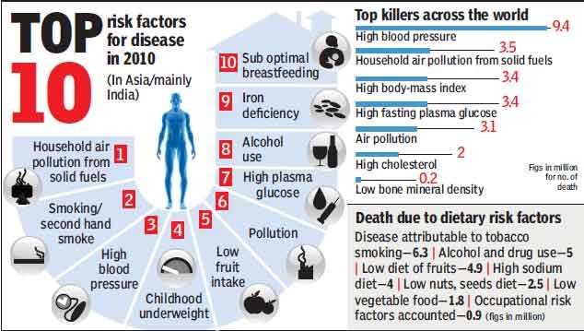
Relevant Data (contd.)
Source: urbanemission.blogspot.com

Slide 6
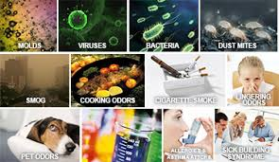
Indoor Air Pollutants
Constituents that causes the pollution
Actual active matters that decreases IAQ
Fuel burning, cigarettes' smoke, paints, pesticides, perfumes, adhesives are the major artificial sources
Bacteria, ozone, radioactive elements are natural sources
Source: germaflux.com.sg

Slide 7
Common pollutants and effects
Second hand smoke
Carbon Monoxide
Asbestos fibers
Carbon Dioxide
Volatile organic compounds
Other particulates
Ozone
Bacteria
Molds and other allergens
Radon

Slide 8
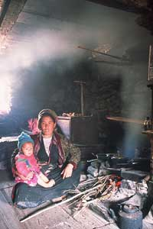
Second hand smoke
It is a tobacco smoke which affects the people other than active smoker
Process also known as passive smoking
Includes both gaseous and particulate phase, CO and small particulates (at PM 2.5 size)
Can pass through lungs natural defense
Increases infant mortality rate by 80%
Pneumonia in newly born child is likely to be 40%
Respiratory infection and cancer
Source: practicalaction.org

Slide 9
Radon
Invisible radioactive atomic gas
Obtained from radioactive decay of radium
Released from soils and rocks
Found in building; highest level occur in basement and the ground floor
Most pervasive indoor pollutant in US and Europe
In US most lung cancer is caused by radon exposure [ Wikipedia]
Causes skin burning, irritation, genetic disorder, cancer

Slide 10
Molds and other allergens
They are biological chemicals
Arise due to moisture growth of mold colonies or from natural substances like animal dander
Some molds contain toxic compounds like mycotoxins
Headache, asthma, conjunctival irritation, allergy are common effects

Slide 11
Carbon monoxide
A colorless, odorless but most acutely toxic
Produced due to incomplete combustion of fossil fuels
Automobile exhaust serves as other prime source
Causes sleepiness, confusion, disorientation, unconsciousness, coma and finally death
1% of CO in atmosphere means no life in Earth

Slide 12
Volatile organic compounds
Emitted as gases from liquids or solids
Paints, lacquers, perfumes, cleaning supplies, pesticides, adhesives like dendrites, super glue etc serve as prime source
Office equipments like printers, glues, permanent markers are also common sources
Acrolein and formaldehyde are emitted from overheated oil
Causes irritation, drowsiness, headache, allergy
Fatal diseases like kidney damage, liver infection, central nervous system disorder, cancer are also more common effects

Slide 13
Bacteria
Bacteria and viruses are all over us
Bacteria like Legionella, Mycobacterium tuberculosis, Staphylococcus aureuse are resulted from outbreaking of medical facilities
Causes airborne and waterborne diseases
Causes loss of immunity and enhance other diseases

Slide 14
Asbestos fibers
Building materials before 1975
Floor tiles, ceiling tiles, shingles, heating systems
When building materials are cut, drilled, cracked then they are released in air as matter
Inhalation causes lung cancer
Slow poison, its effect can be seen no sooner than 30 years of first inhalation

Slide 15
Carbon dioxide
Human are major CO2 producer
EPA has mentioned its occupancy should be less than 500 ppm
Displaces oxygen and can create suffocation
Causes irritation, drowsiness, headache, breathing problem

Slide 16
Ozone
Produced by UV- ray hitting ozone layer, lighting, high voltage devices and also as by products of other pollution
Significant amount in old, smaller jets
Very very reactive
Reacts with cosmetics to produce toxic compounds
Irritating to lung tissue, chest pain; very very harmful

Slide 17
Other particulates
NOx, SOx
Releases from gas stoves
Smoke from mosquito coils
Causes respiratory problems like asthma, breathing problem; irritation...

Slide 18
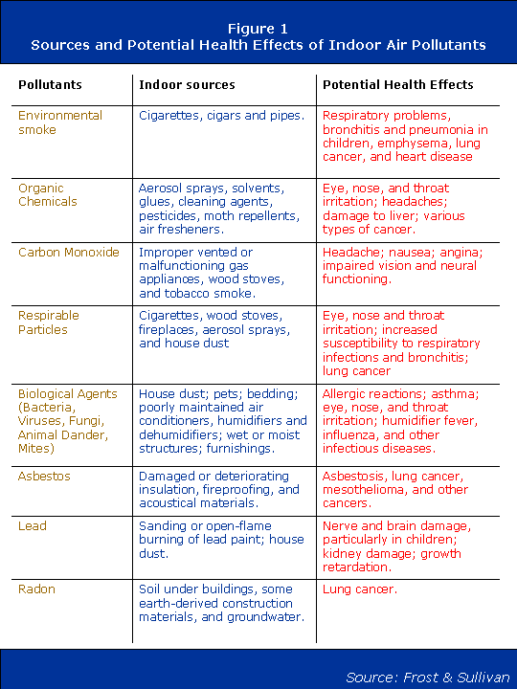
Summary

Slide 19

Thankyou

